Slide 1
Calorimeter Response and Clustering
Sebastian Rotella

Slide 2
Samples Used
Generated by Patrick
Electron, Photon, Pi0, Pi+, K0L, Muon
z0 = 520 cm
x0 and y0 drawn from a flat sample between -10 and +10 cm
pz = [0, 100] GeV (except for Pi0 which was accidentally [0,10] GeV)
px and py = [-1.5, 1.5] GeV

Slide 3
Cluster Algorithm
Compute kmeans clustering with different values of k (from 1-10)
For each k, calculate the within-cluster sum of squares (wcc)
If difference between wcc of previous k value and current k value is greater than a certain threshold (was a more accurate fit), update the optimal number of clusters
This threshold value prevents overfitting clusters to data while still ensuring the “best” optimal number of clusters is found

Slide 4
Cluster Plots
(Showcase of clustering algorithm on EMCal hits for a given event)

Slide 5
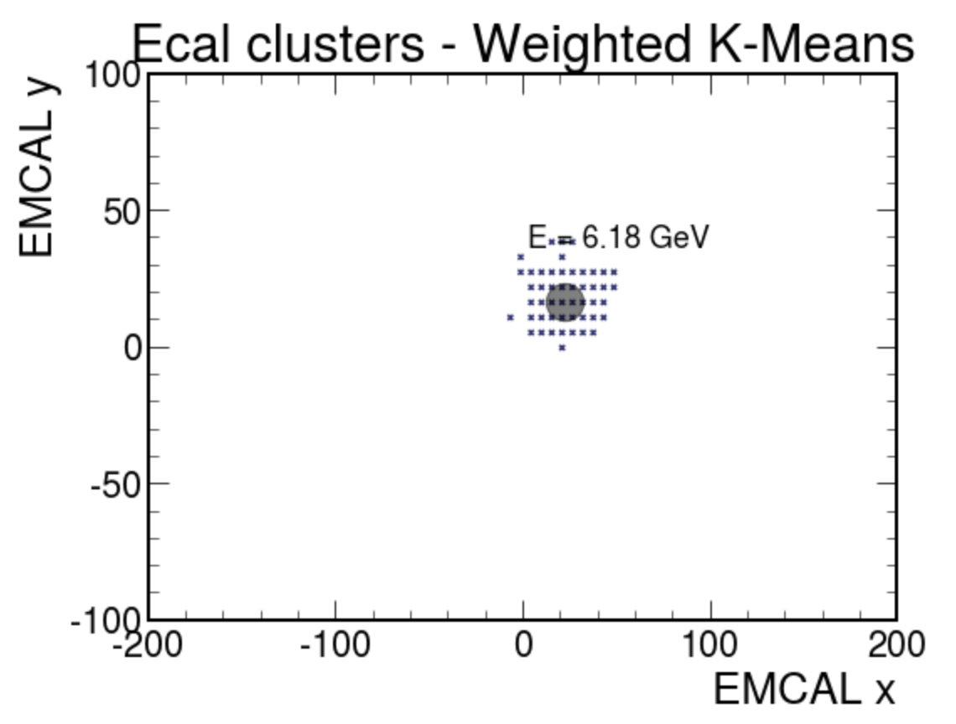
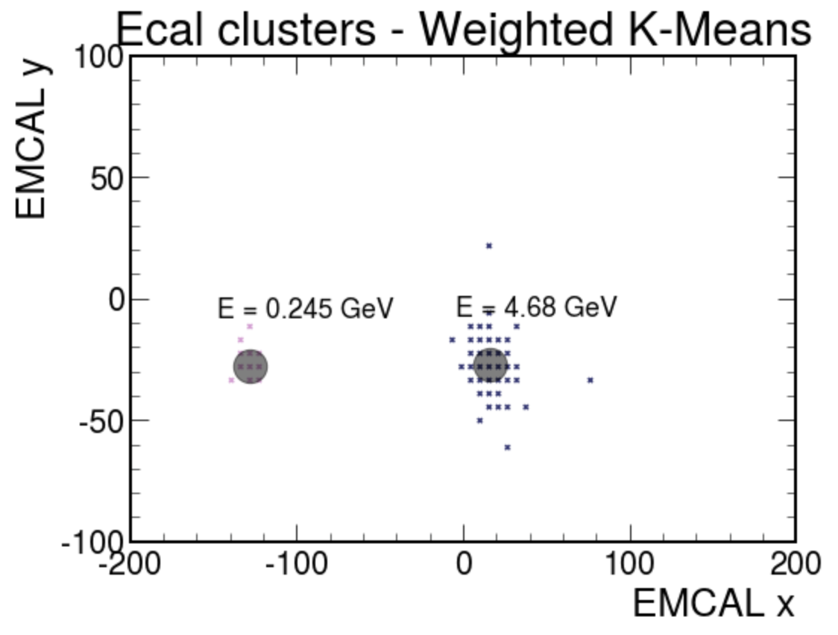
Cluster Plots - Electron

Slide 6
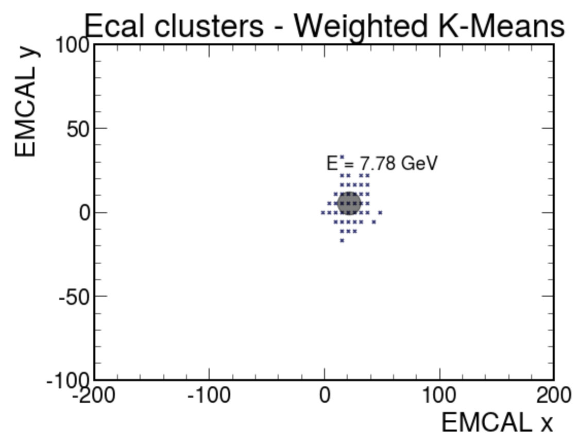
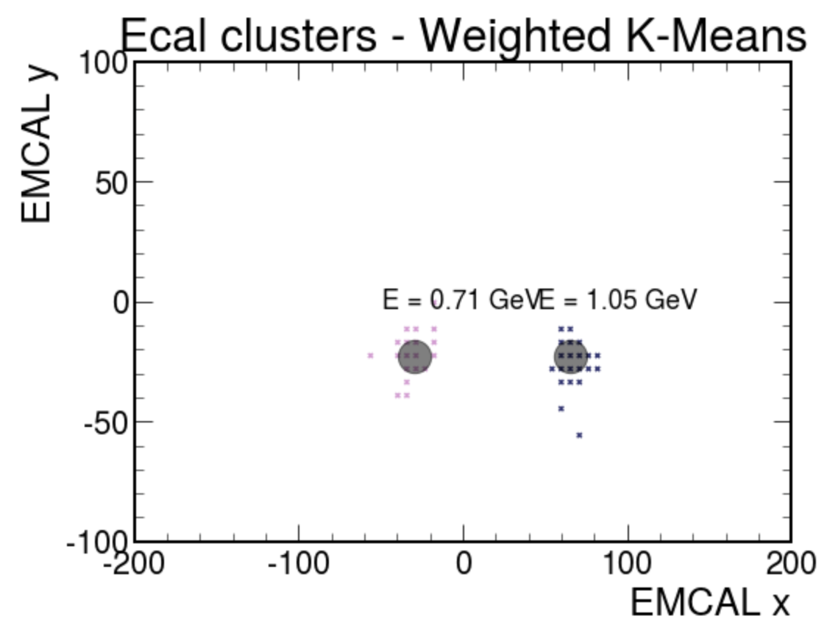
Cluster Plots - Photon (1, 2)

Slide 7
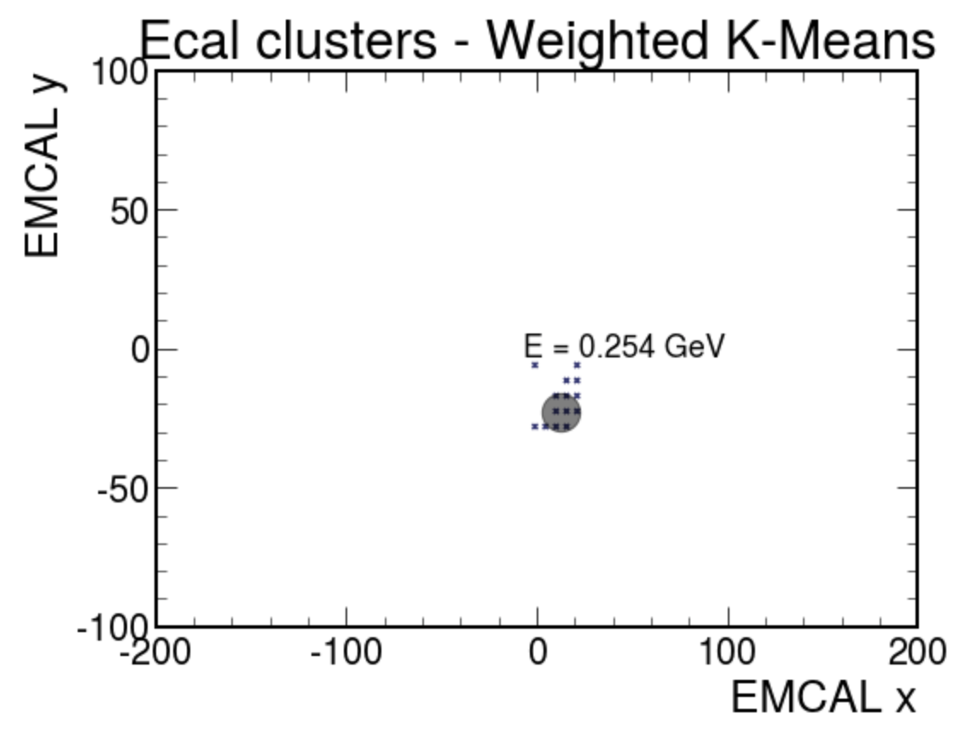
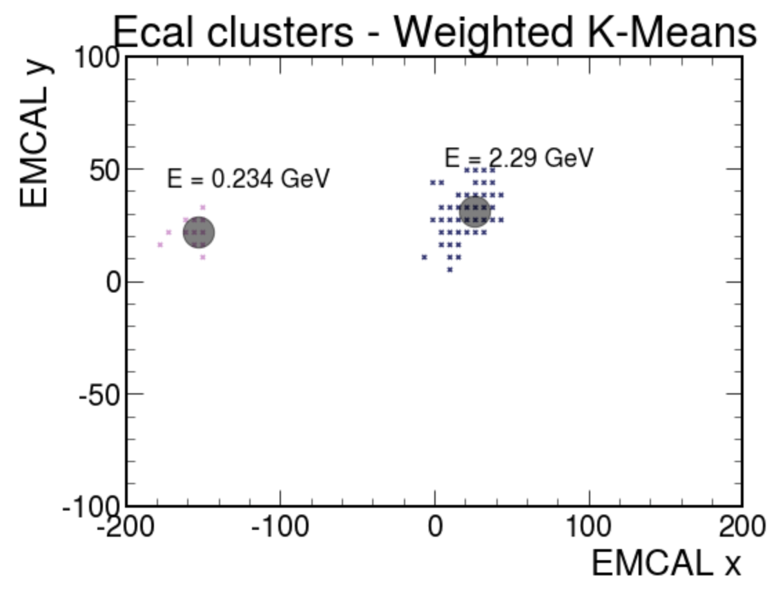
Cluster Plots - Pi+ (1,2)

Slide 8
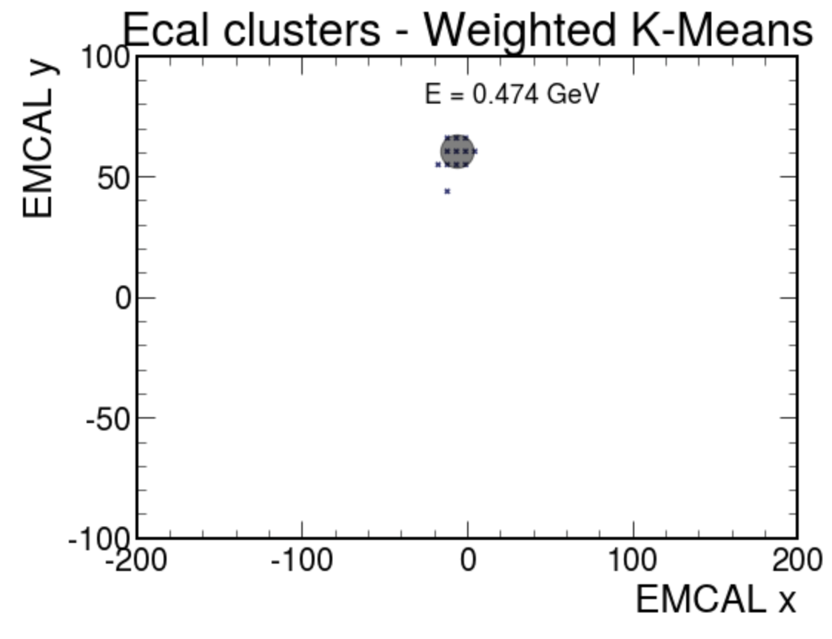
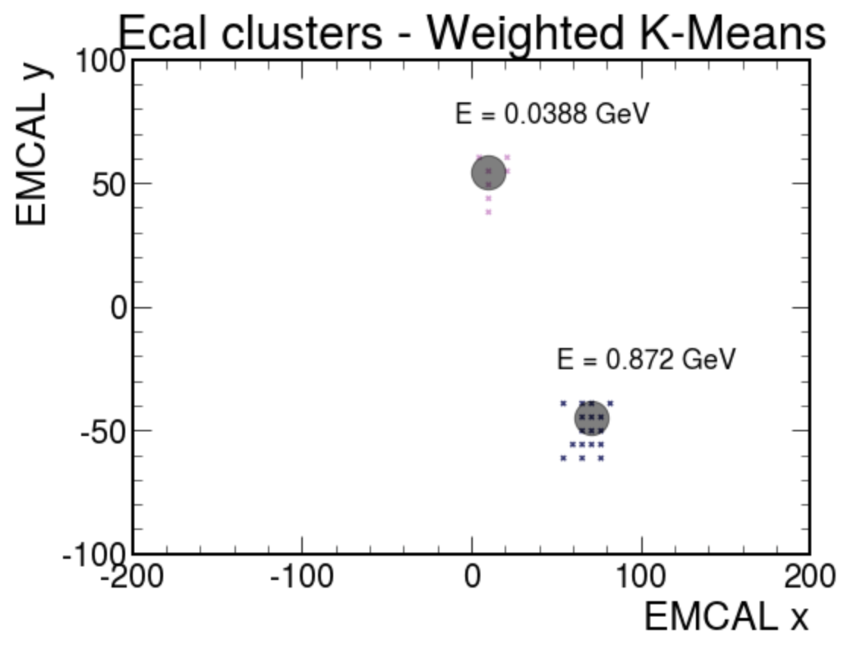
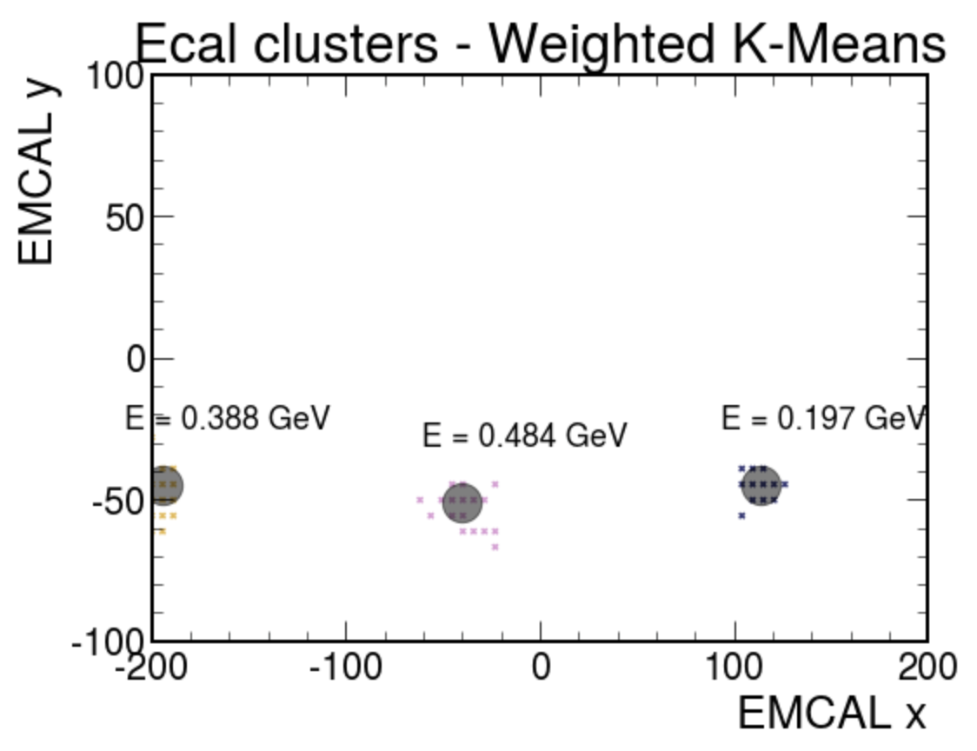
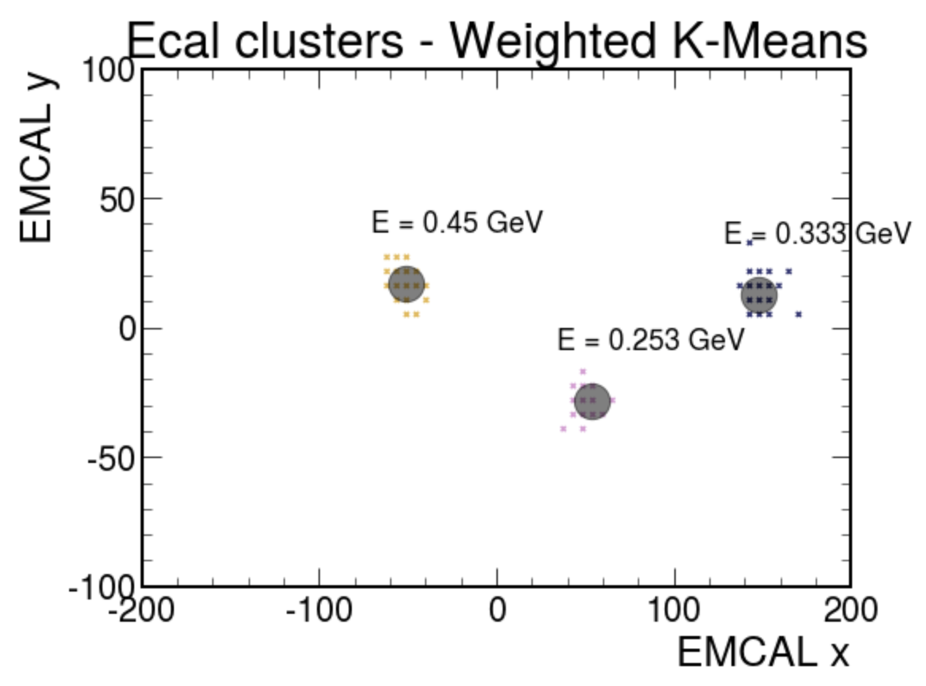
Cluster Plots - Pi0 (1,2,3)

Slide 9
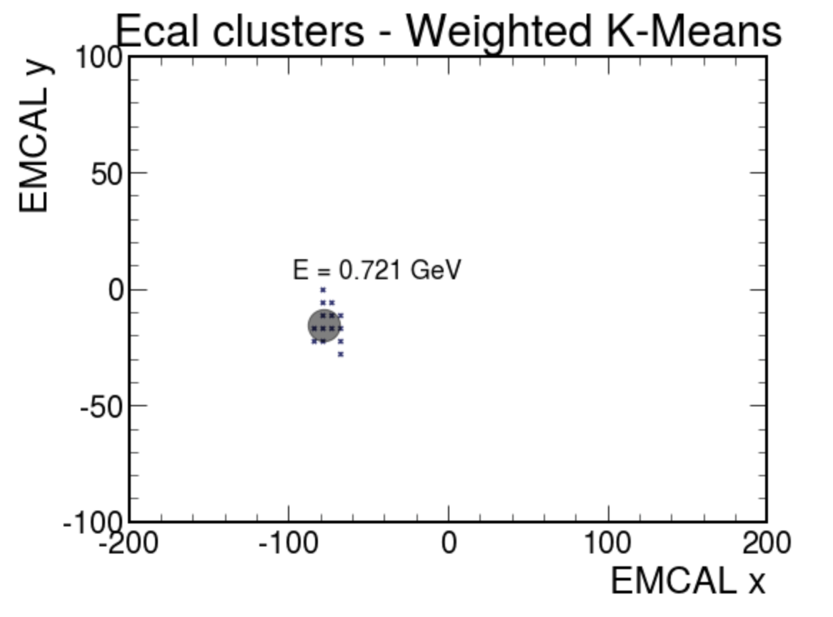
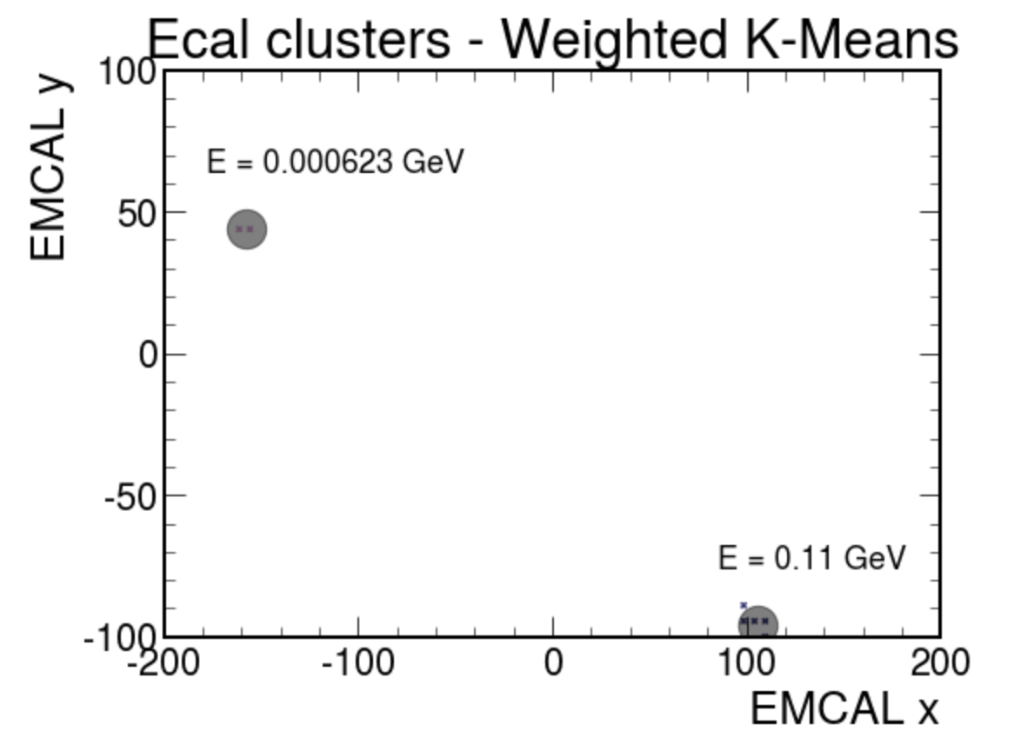
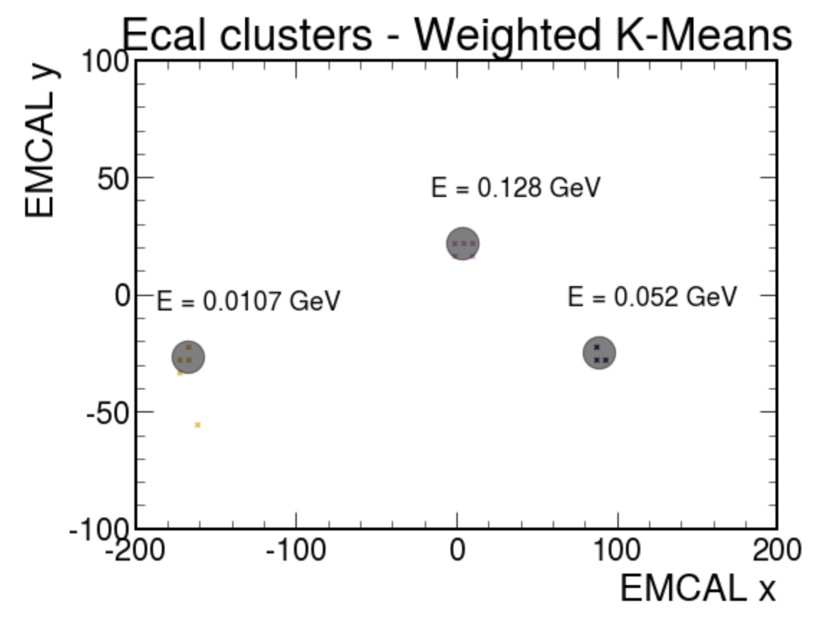
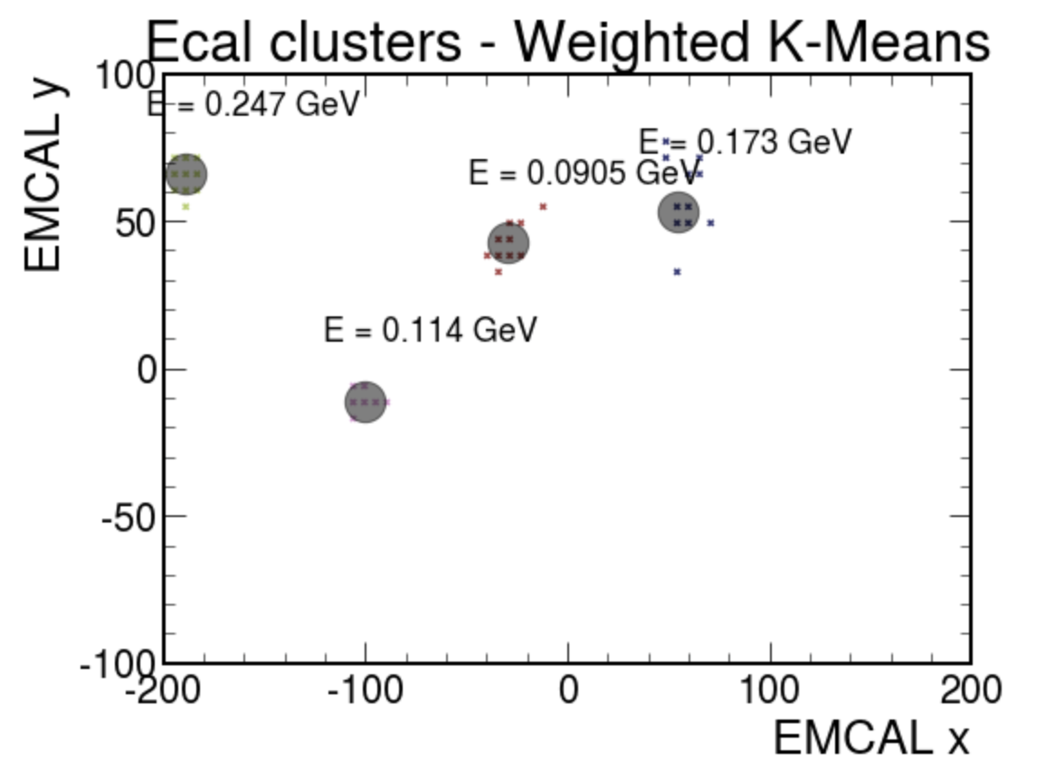
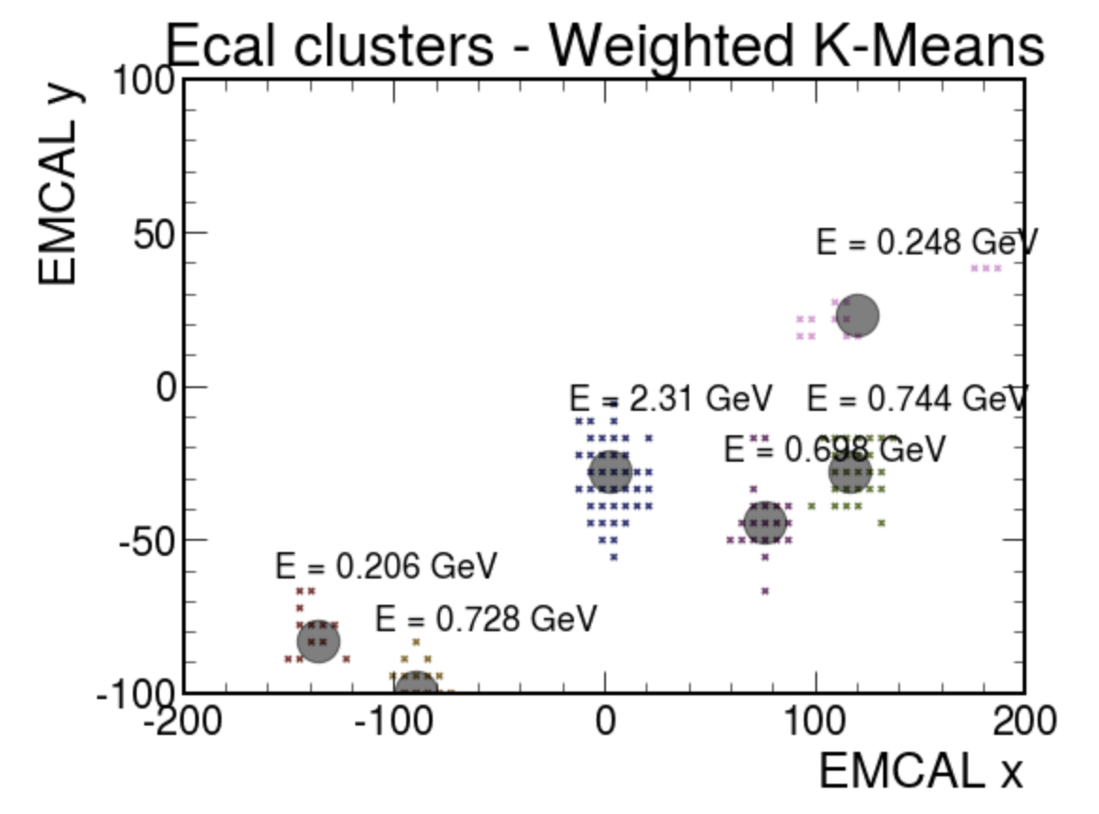
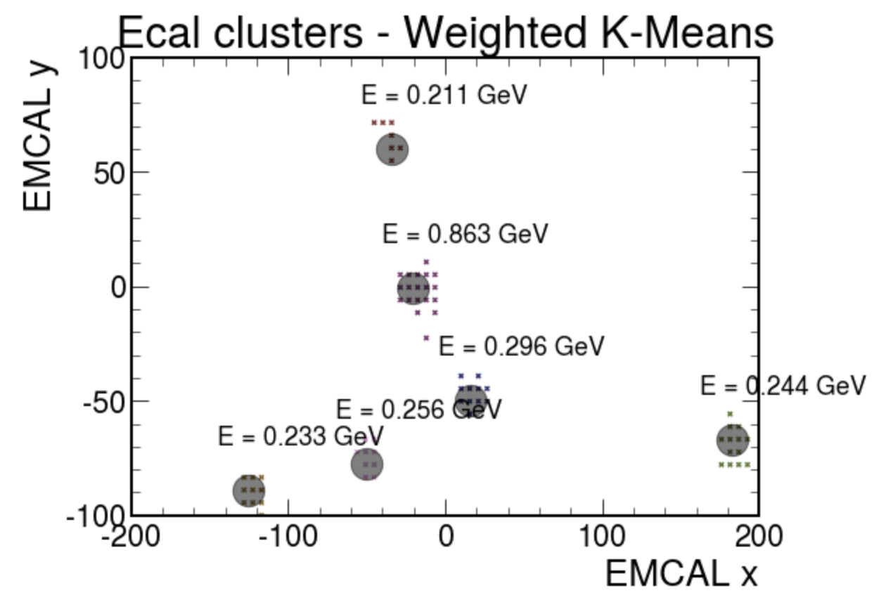
Cluster Plots - Kaon (1,2,3,4,6)

Slide 10
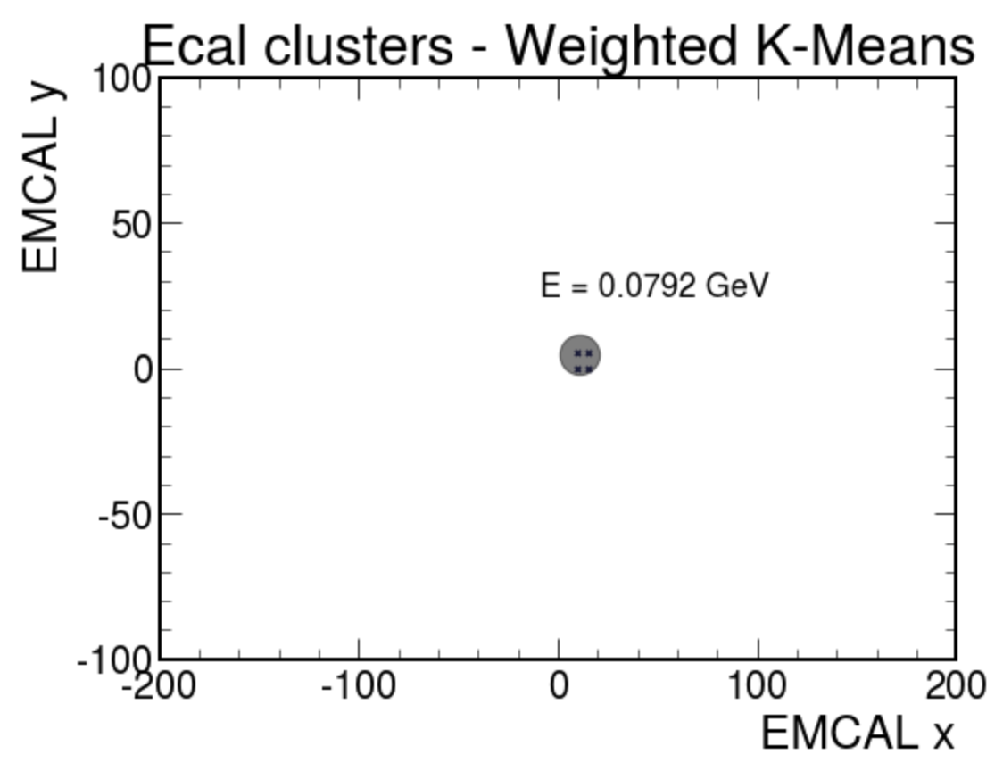
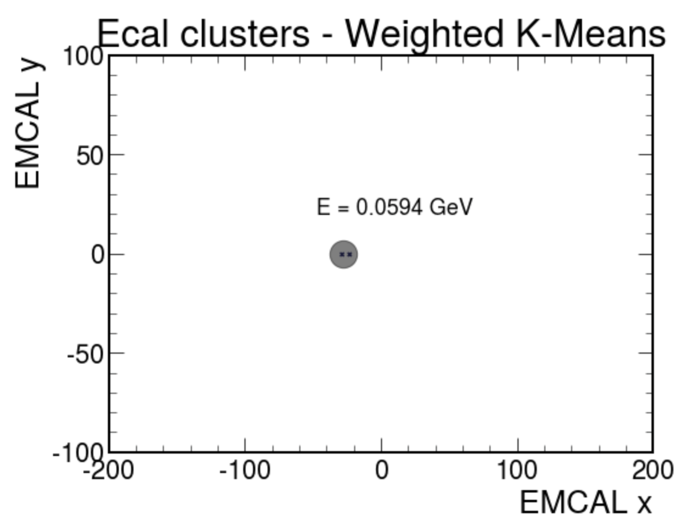
Cluster Plots - Muon (1)

Slide 11
Number of Clusters
(Optimal number of clusters found for each event)

Slide 12
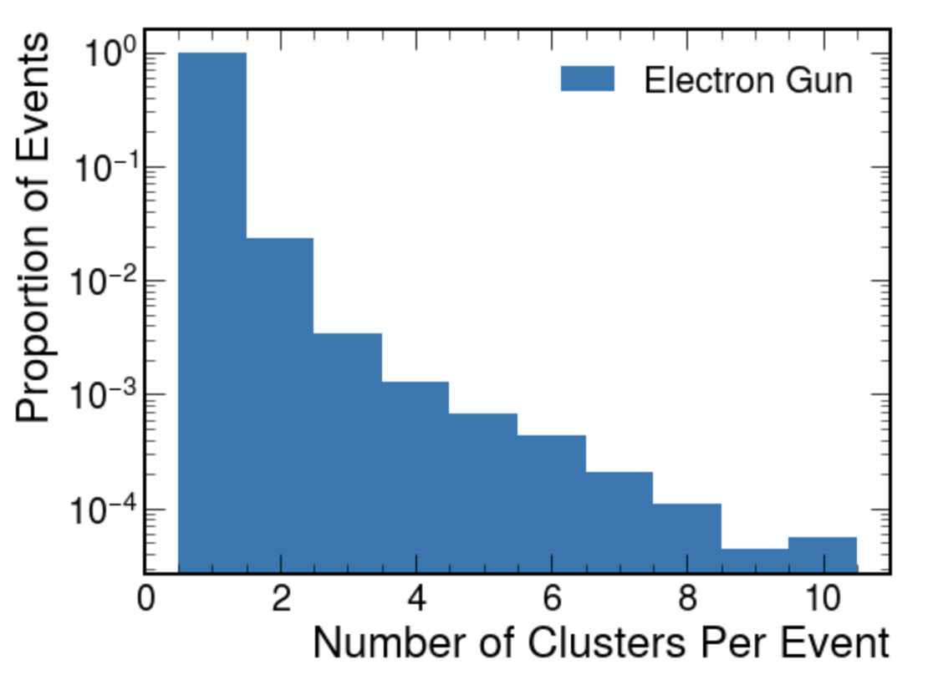
N Clusters - Electron

Slide 13
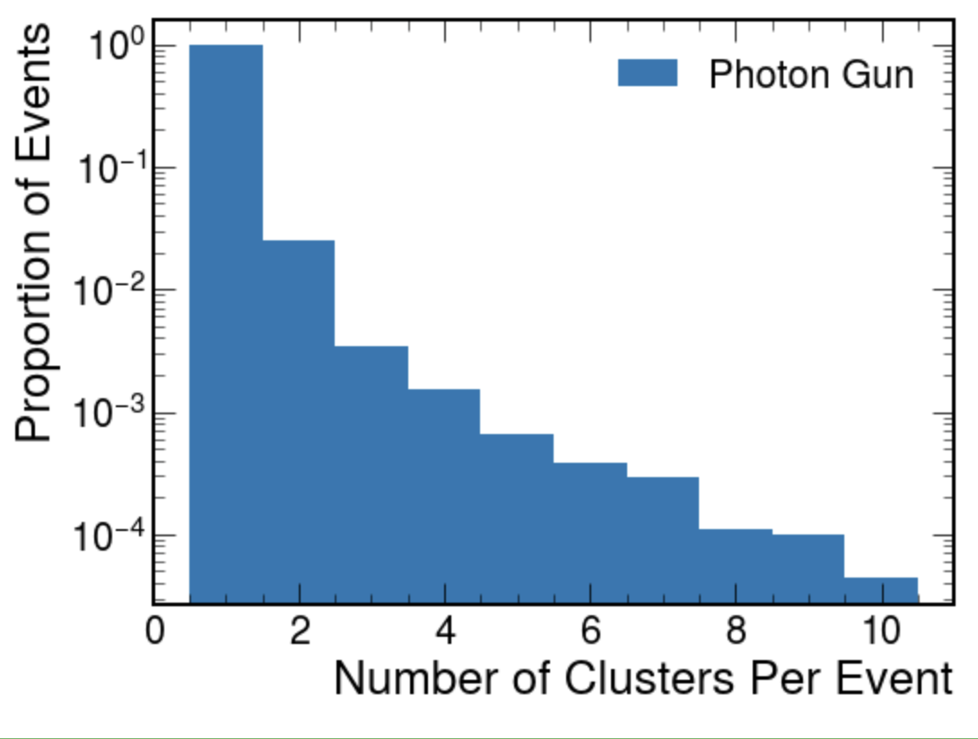
N Clusters - Photon

Slide 14
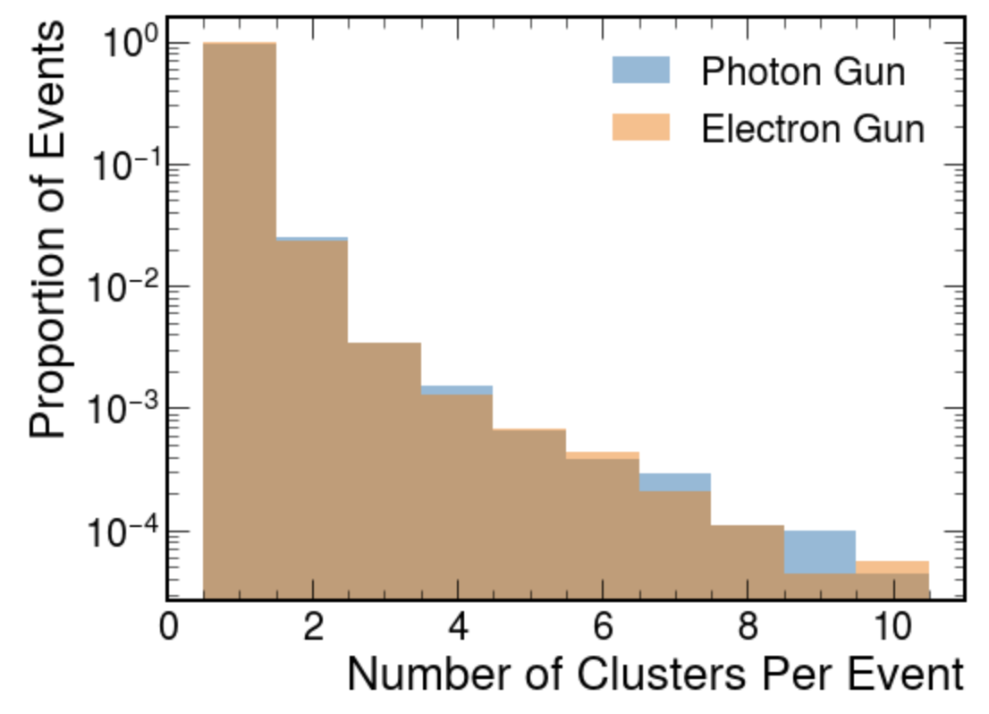
N Clusters - Photon Electron Comparison

Slide 15
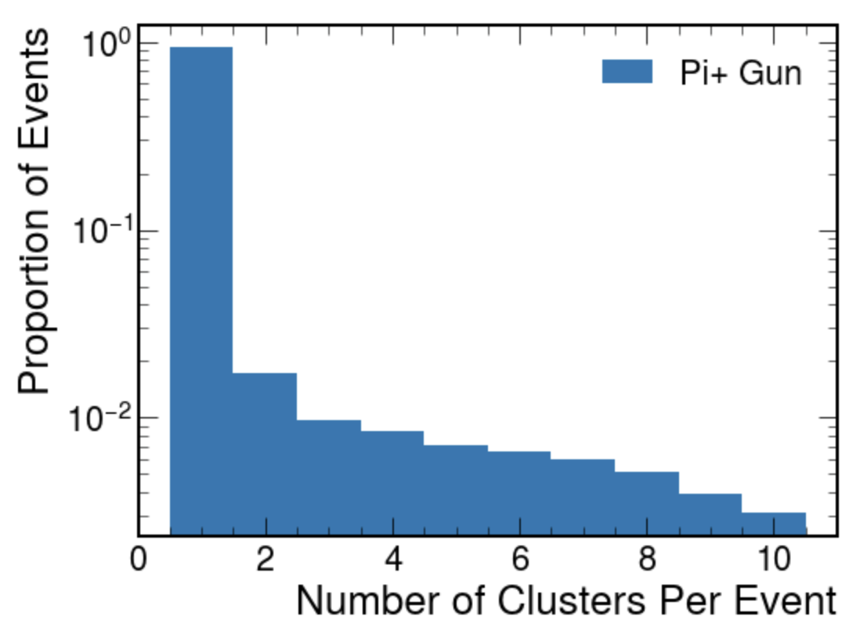
N Clusters - Pi+

Slide 16
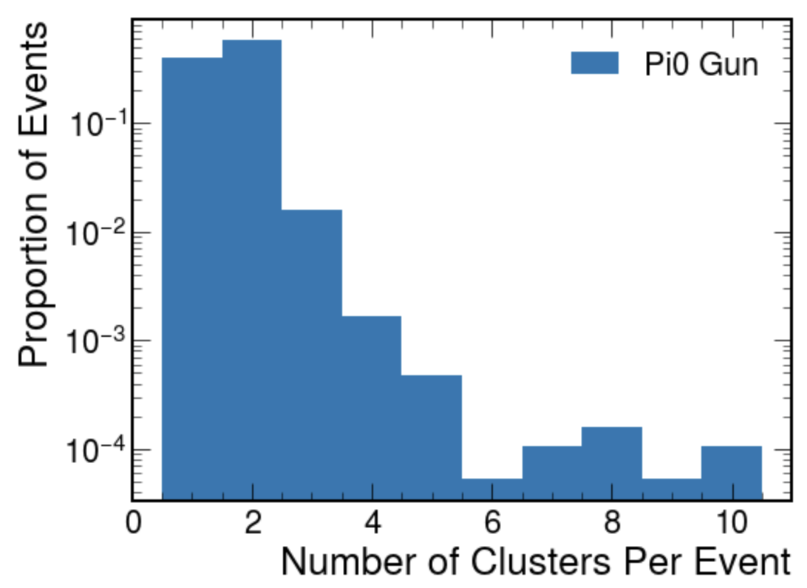
N Clusters - Pi0

Slide 17
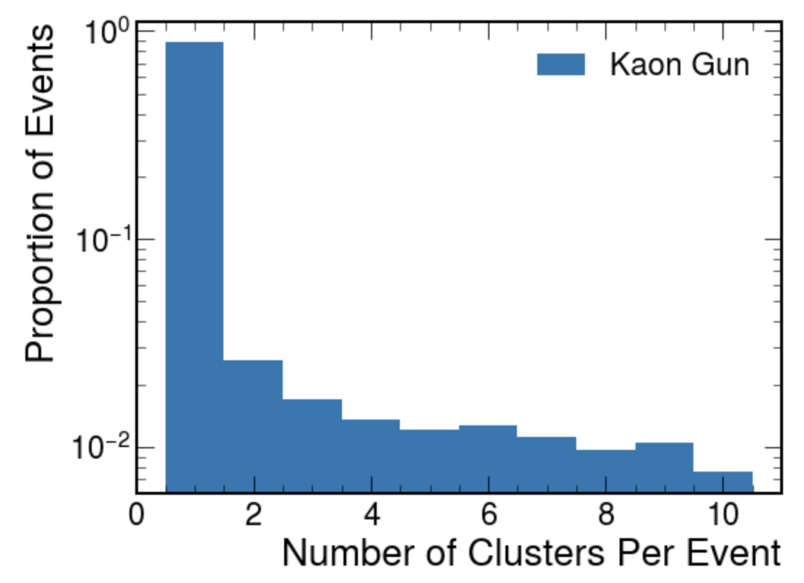
N Clusters - Kaon

Slide 18
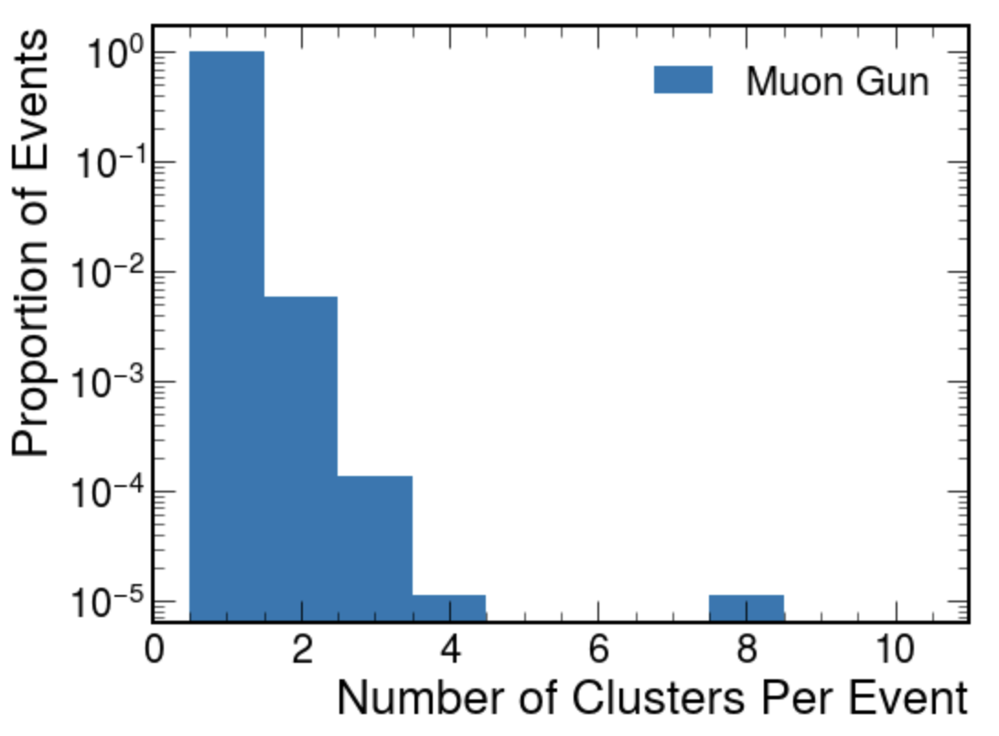
N Clusters - Muon

Slide 19
E_reco/E_corr vs E_gen
(E_gen = truth particle energy
E_reco = total deposited energy in EMCal
E_corr = deposited energy corrected by sampling fraction)

Slide 20
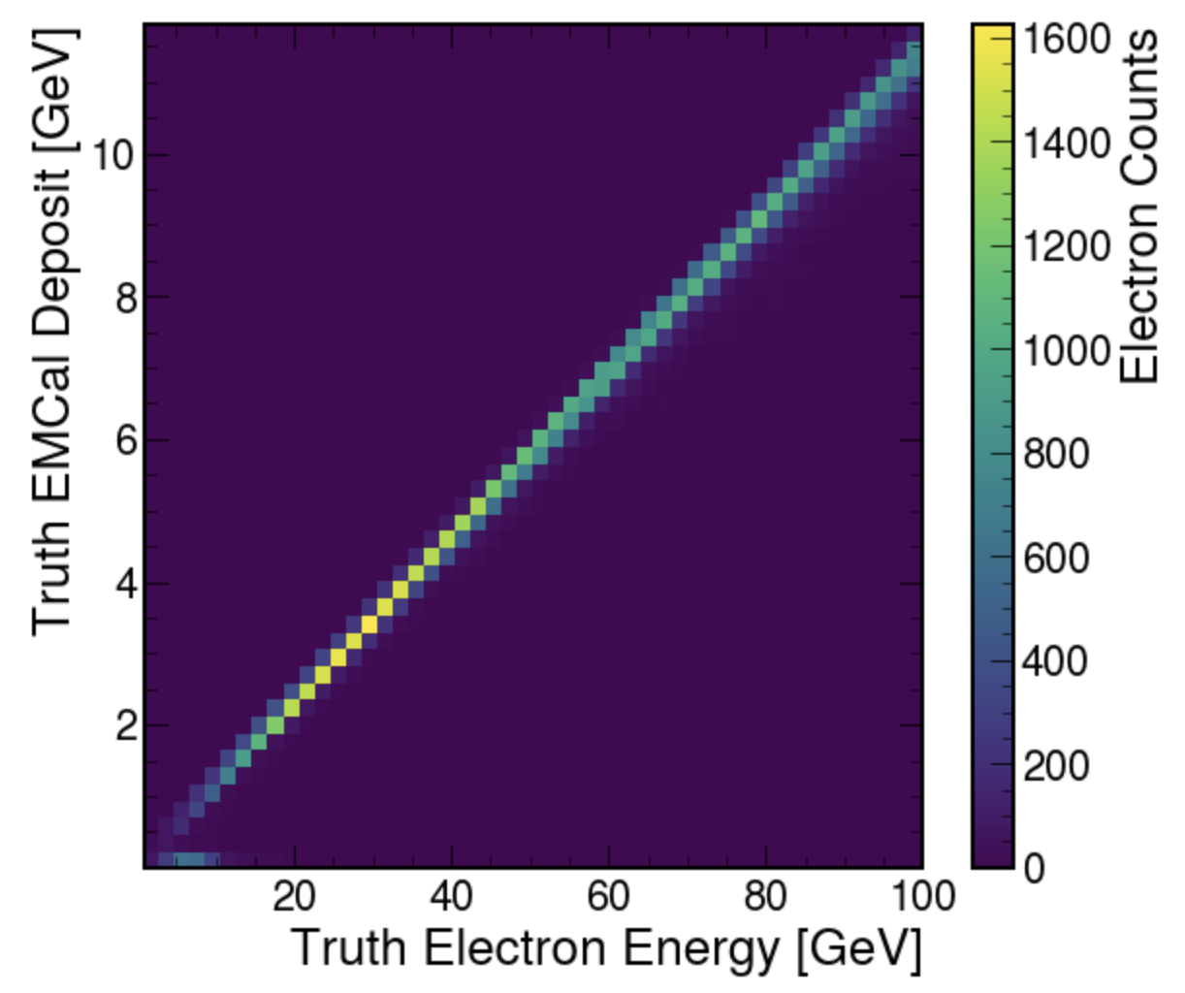
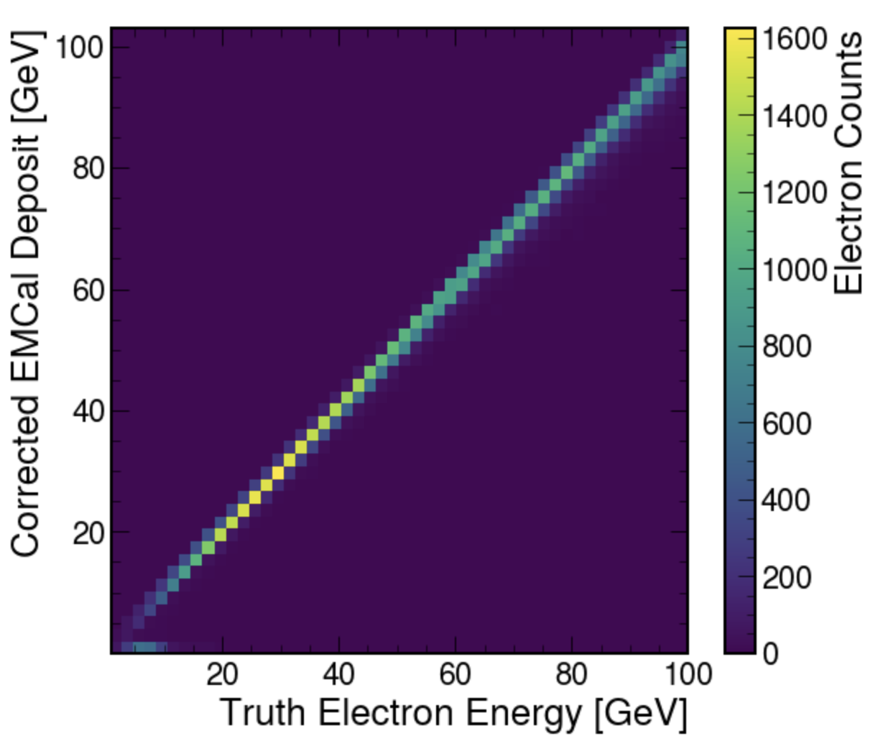
E_reco vs E_gen and E_corr vs E_gen - Electron

Slide 21
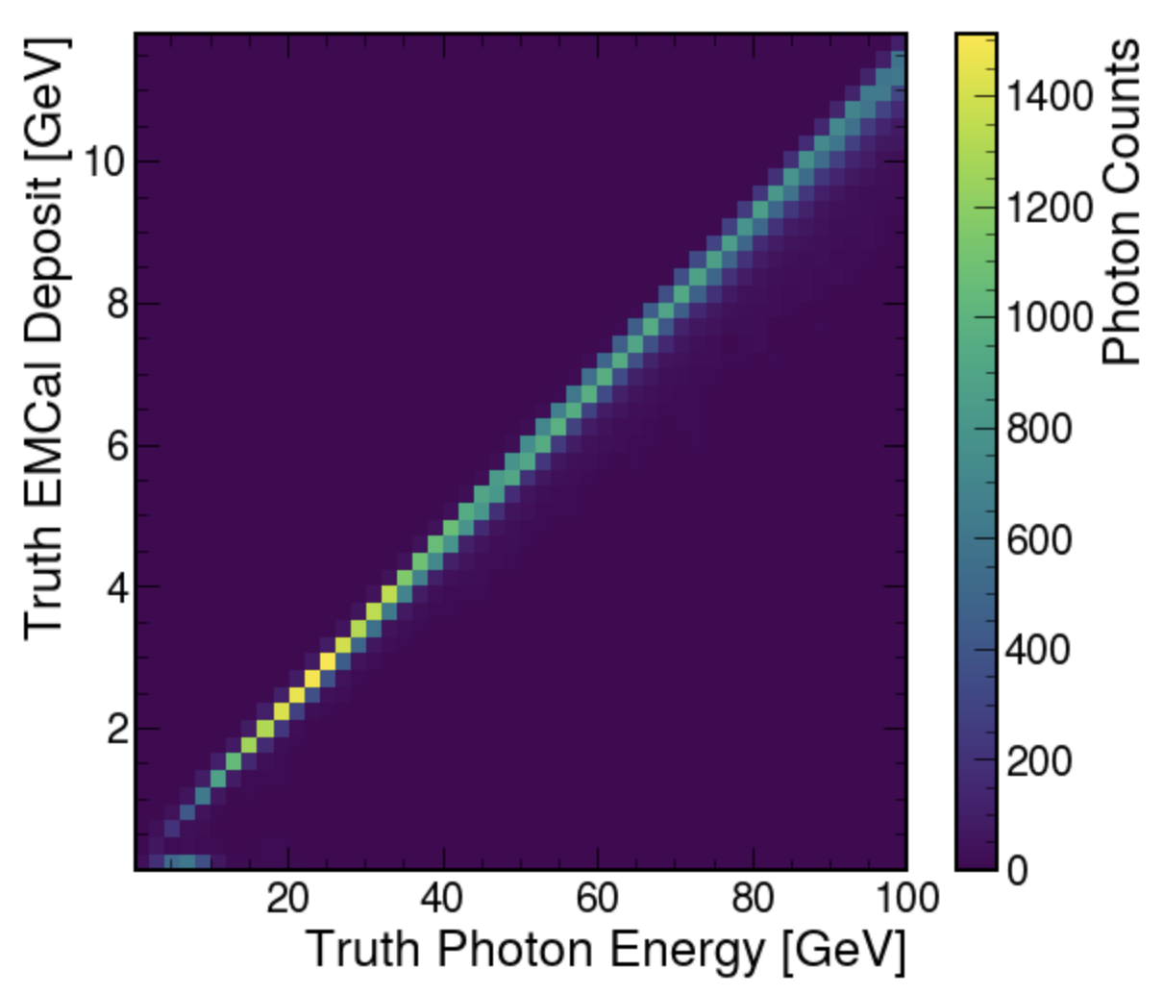
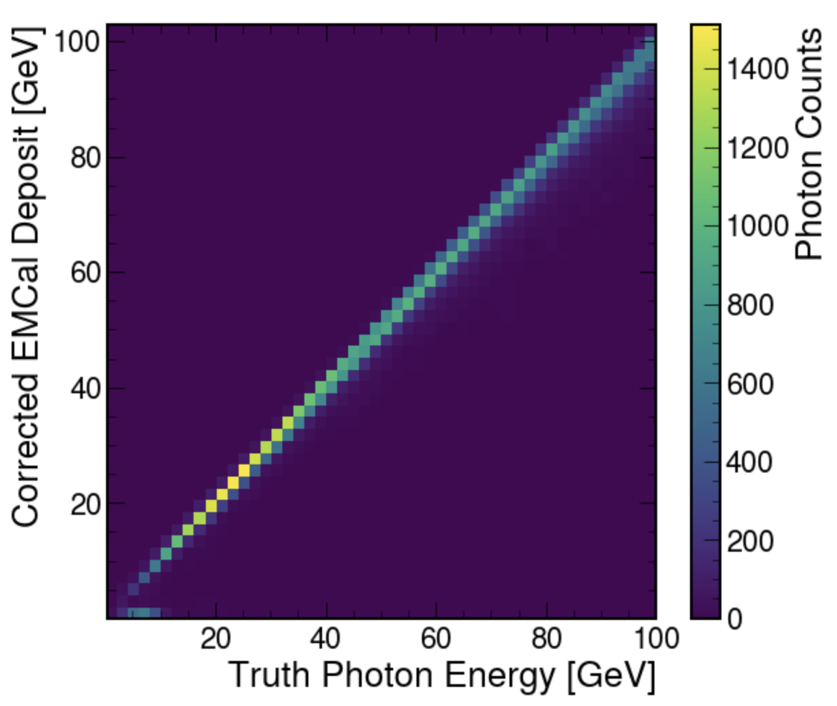
E_reco vs E_gen and E_corr vs E_gen - Photon

Slide 22
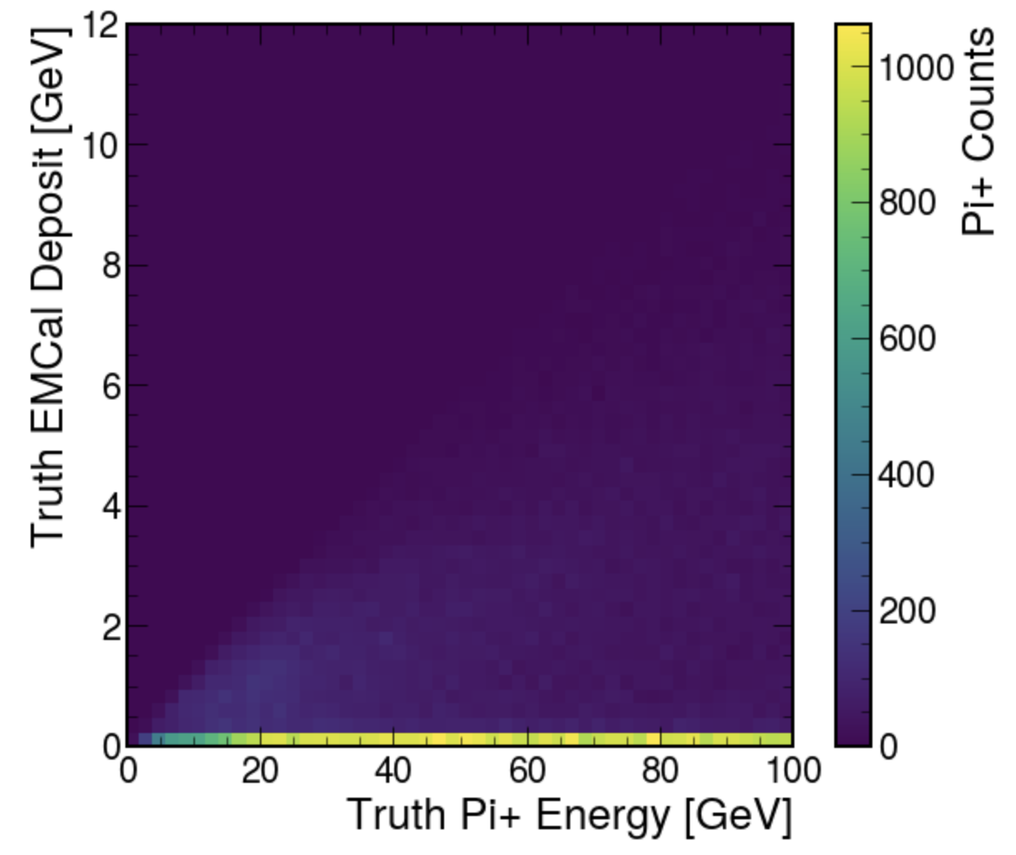
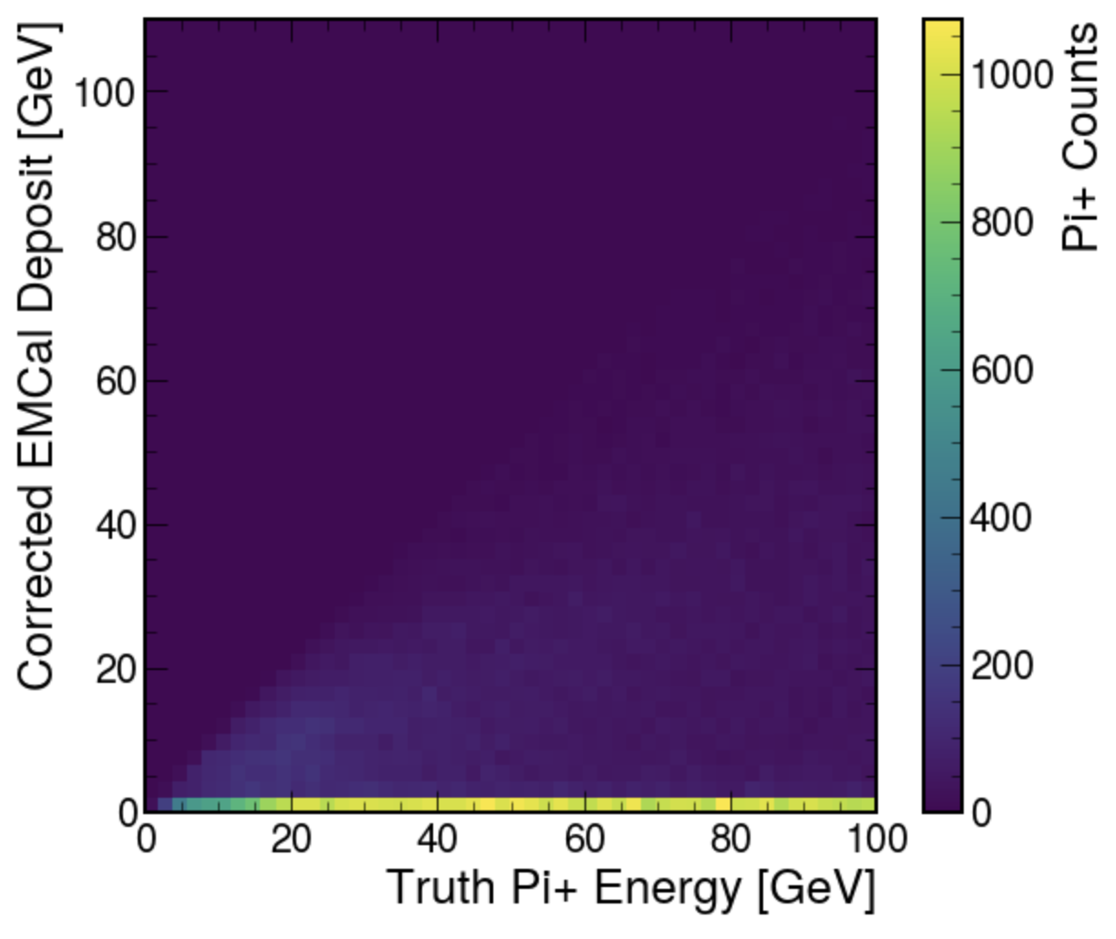
E_reco vs E_gen and E_corr vs E_gen - Pi+

Slide 23
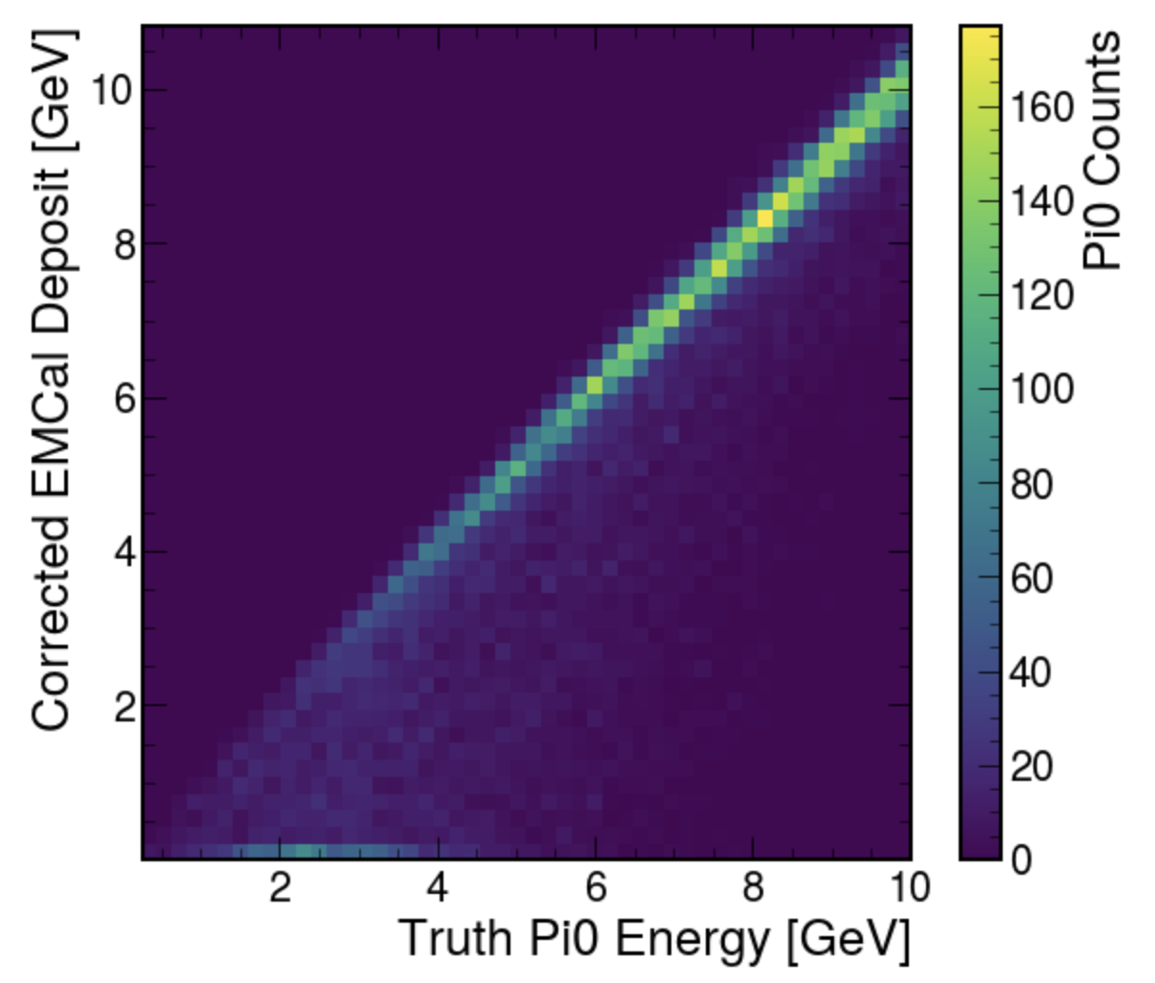
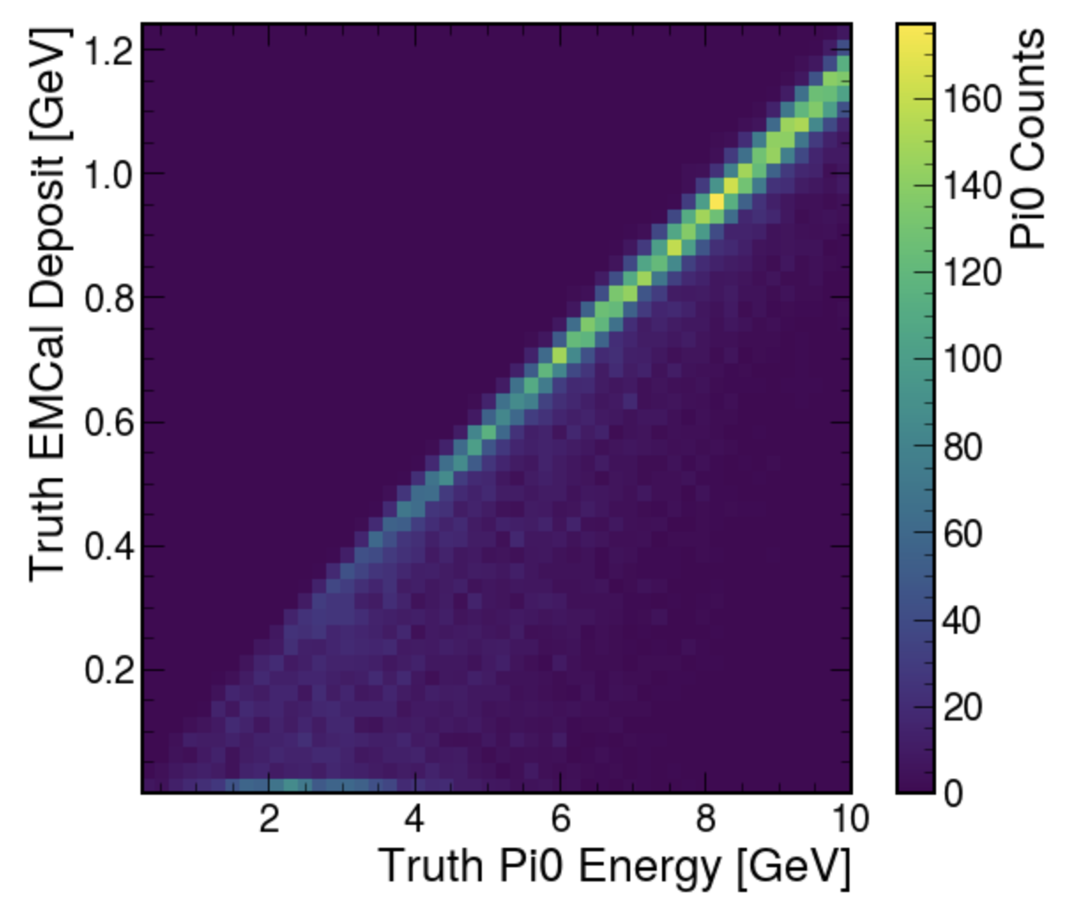
E_reco vs E_gen and E_corr vs E_gen - Pi0

Slide 24
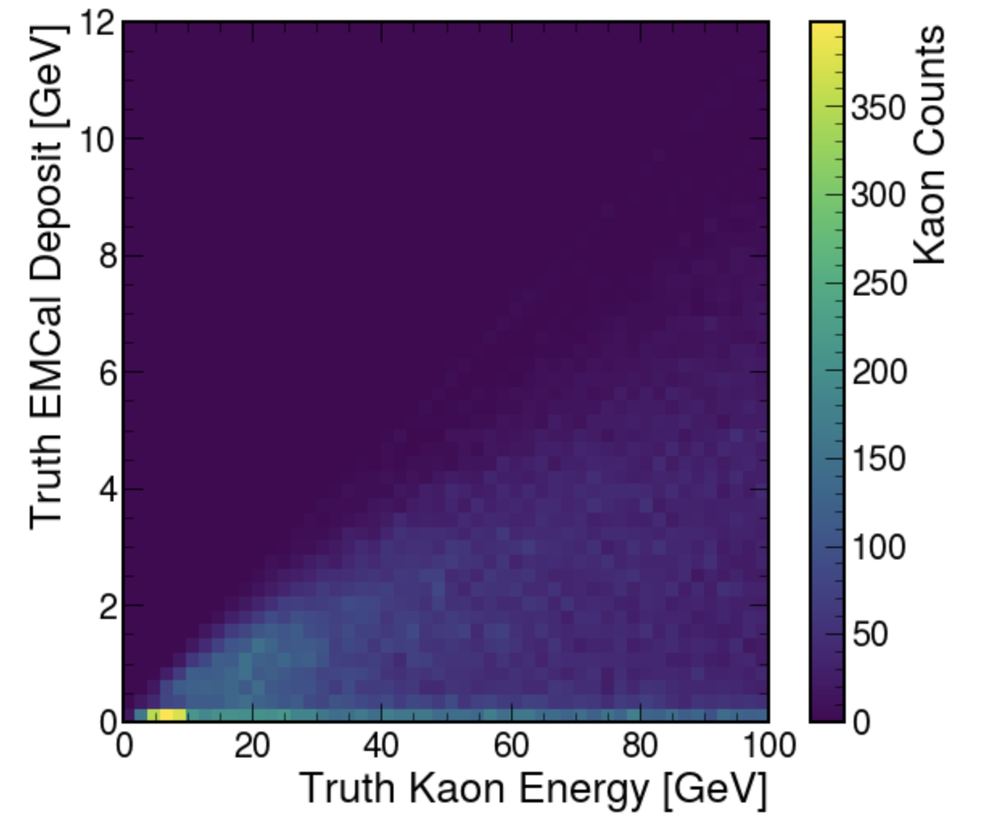
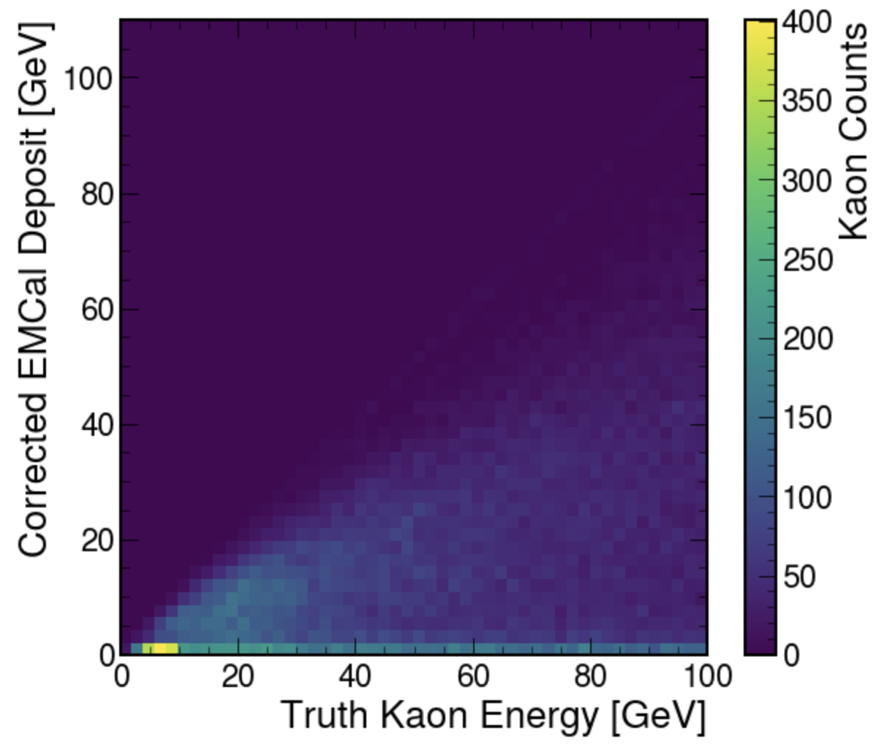
E_reco vs E_gen and E_corr vs E_gen - Kaon

Slide 25
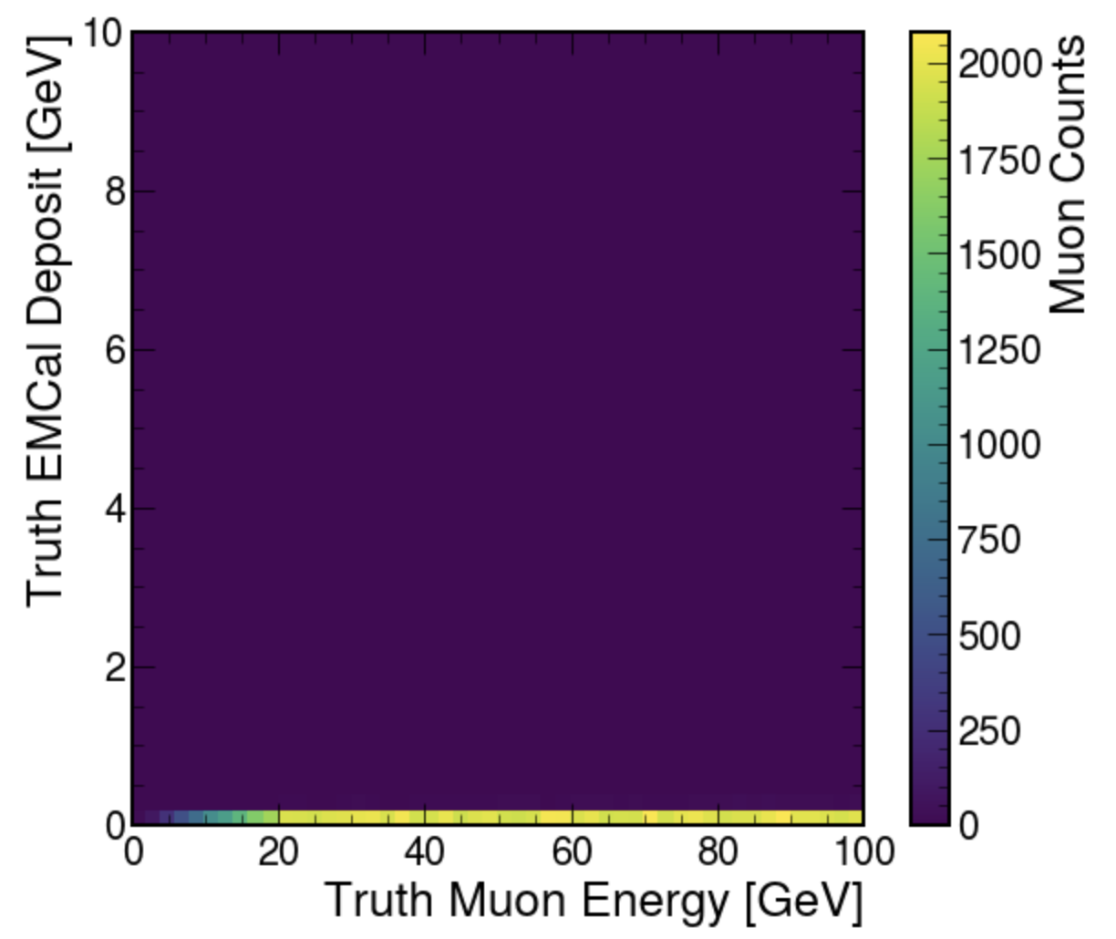
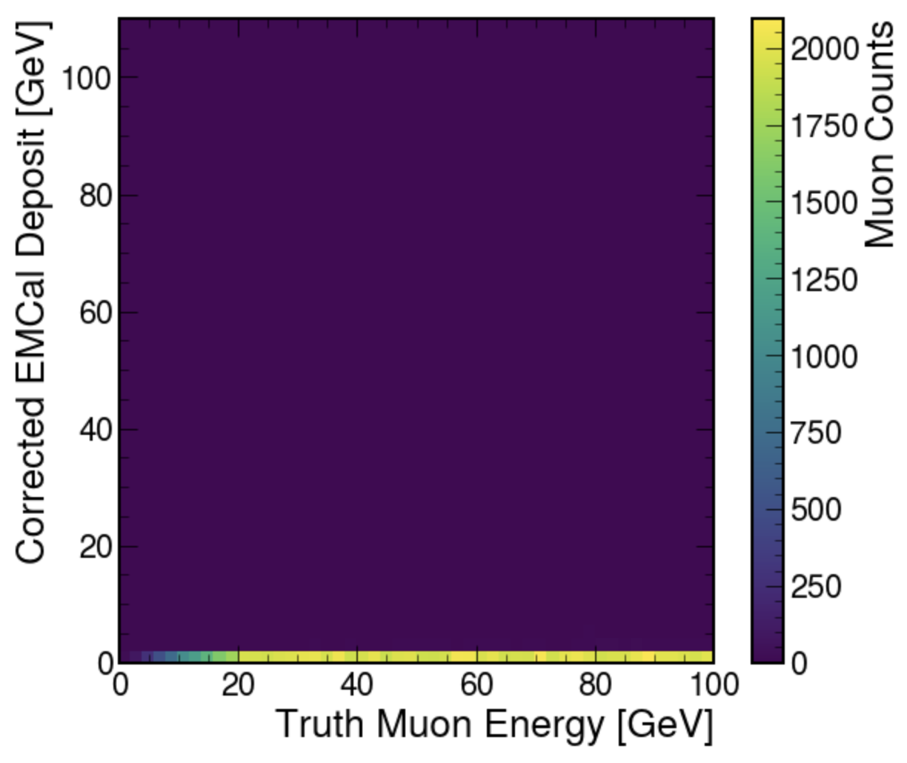
E_reco vs E_gen and E_corr vs E_gen - Muon

Slide 26
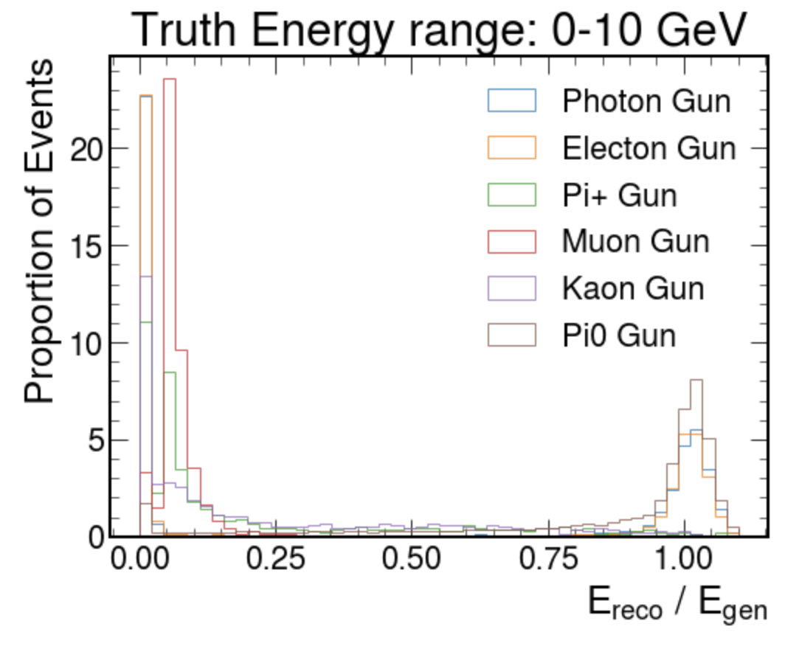
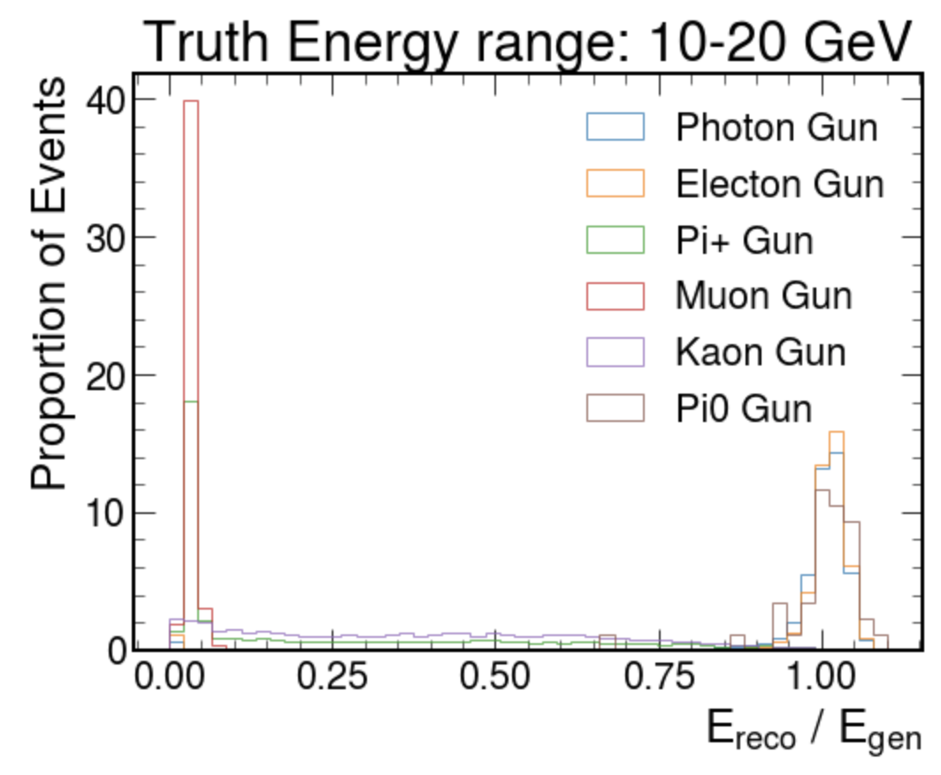
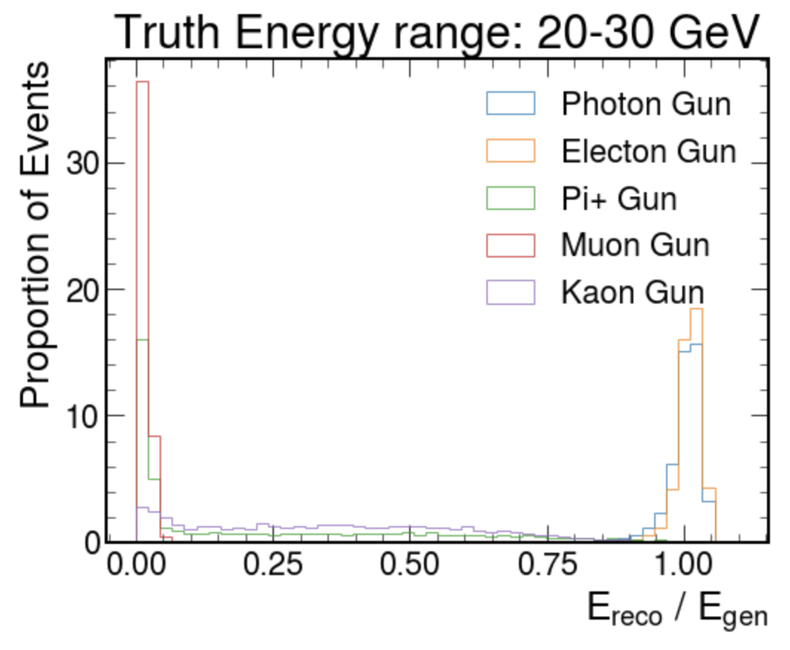
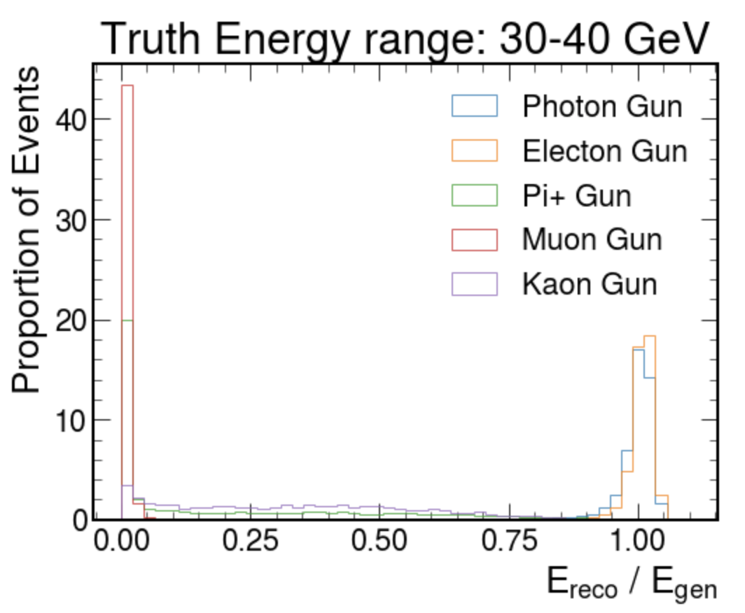
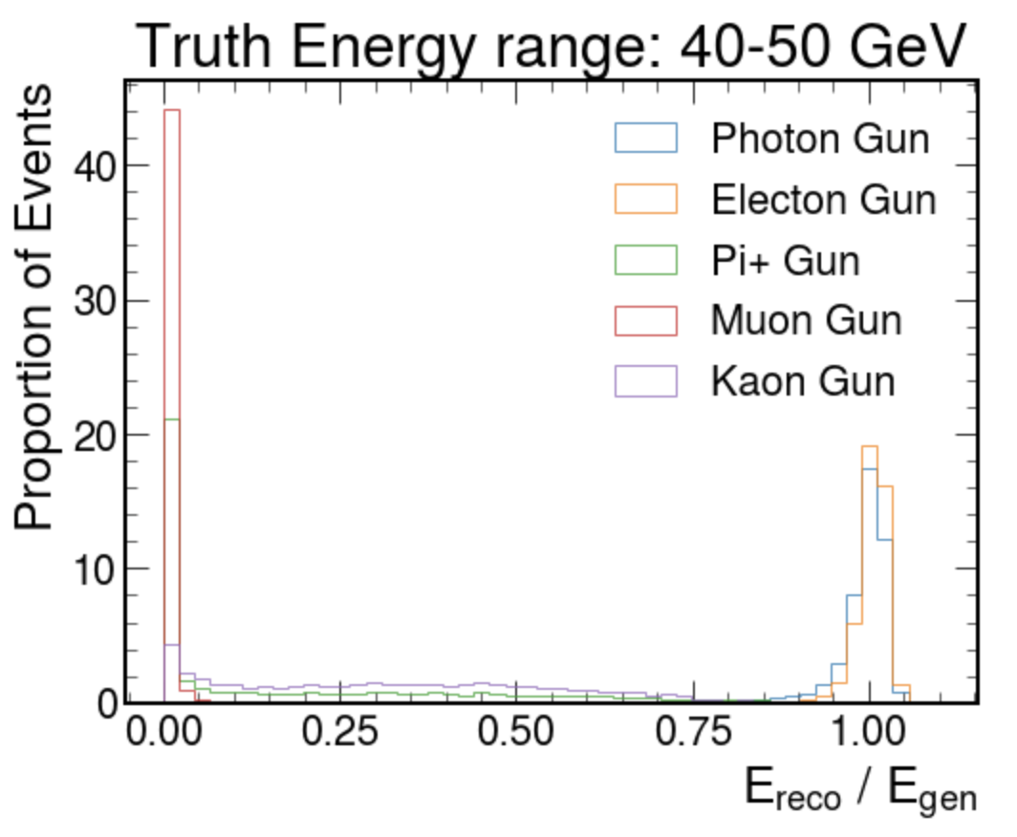

Slide 27
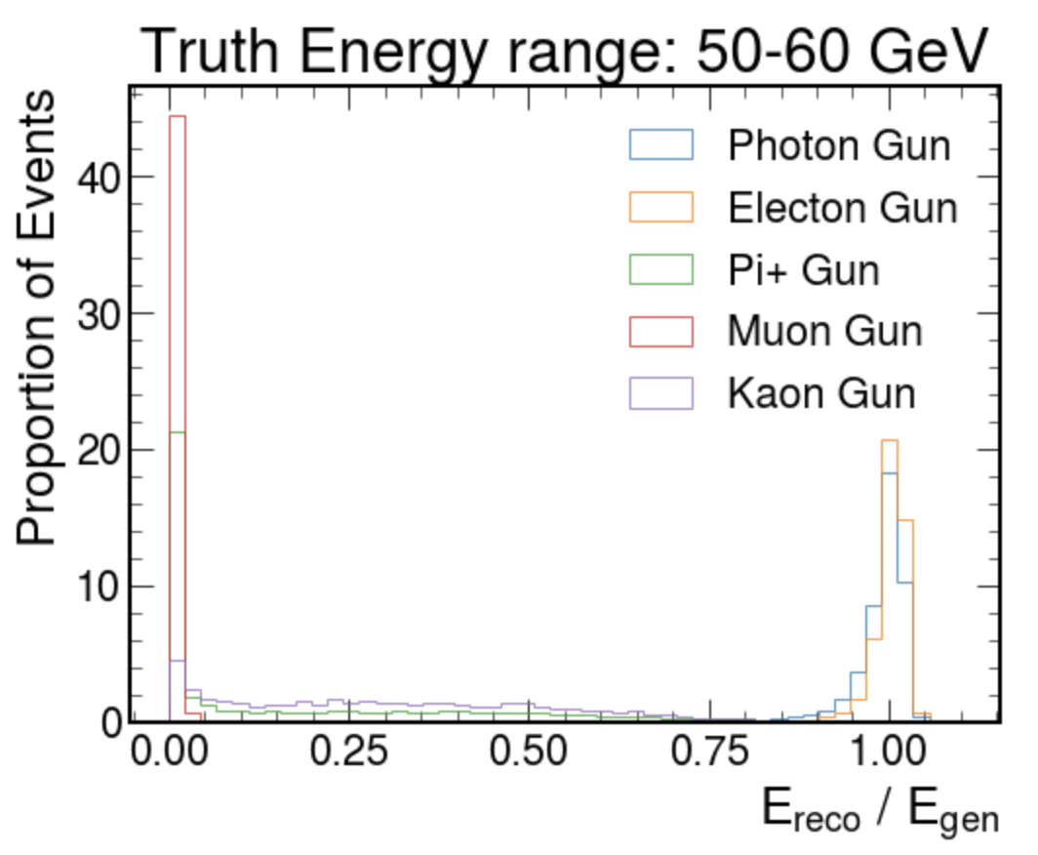
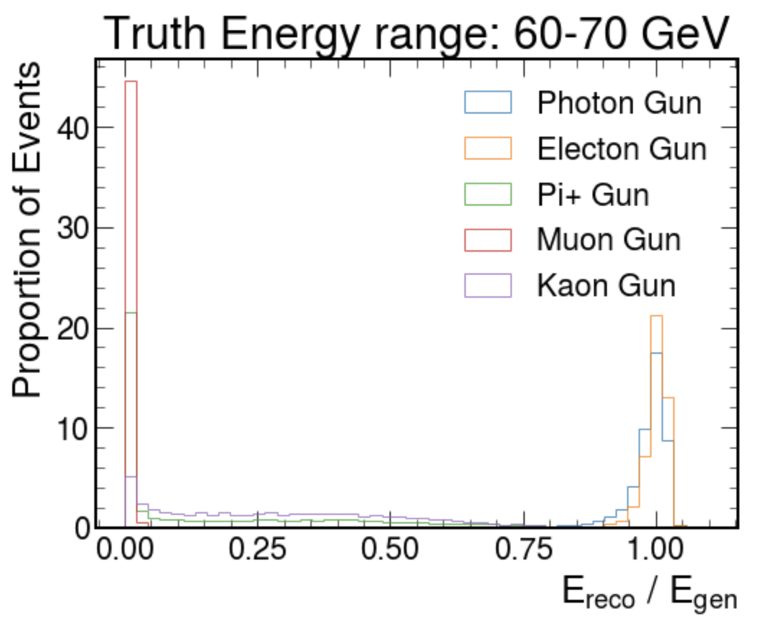
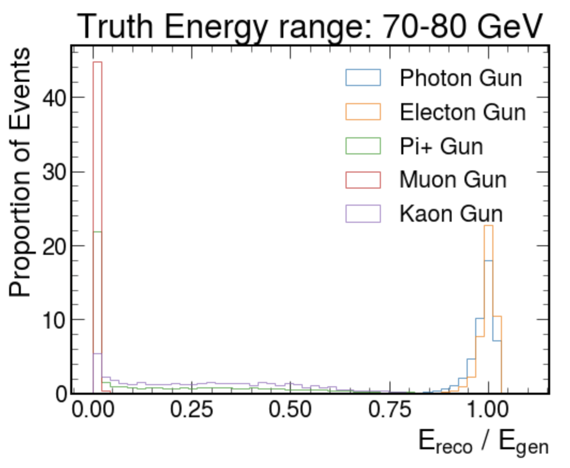

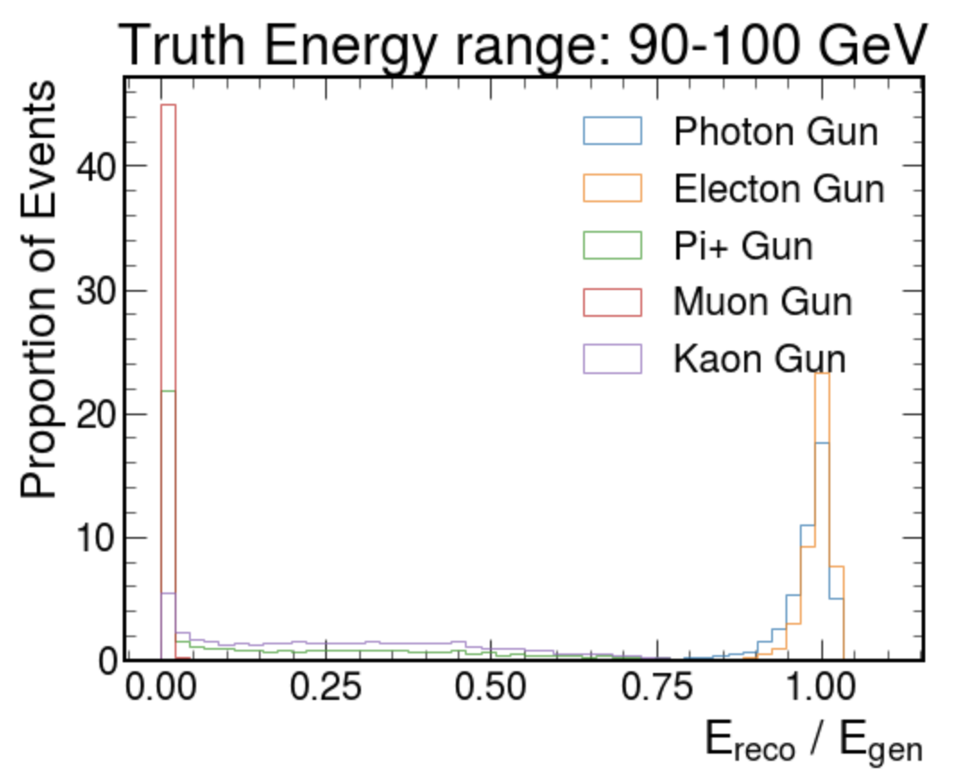

Slide 28
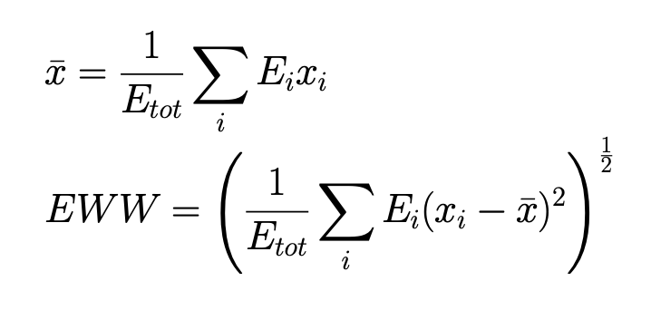
Energy Weighted Width (of Leading Cluster)

Slide 29
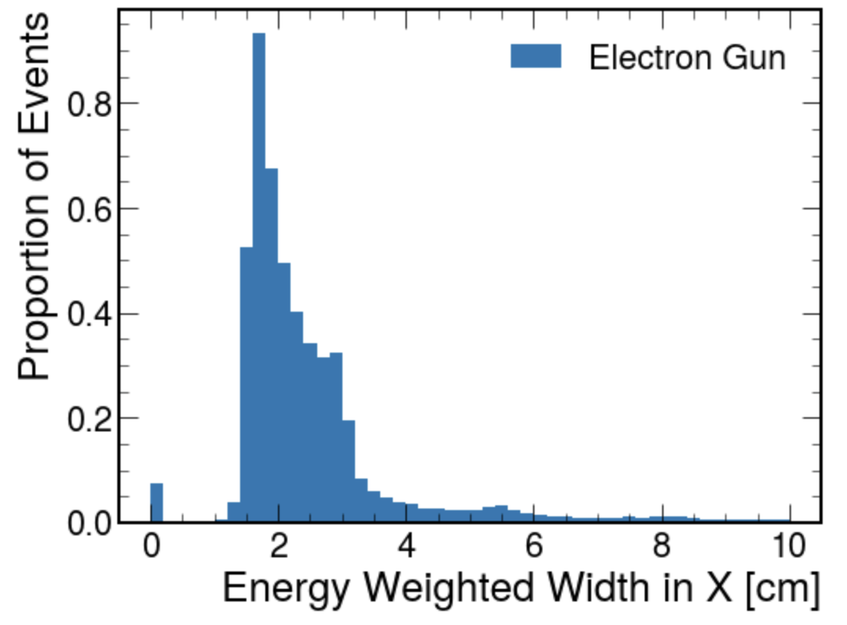
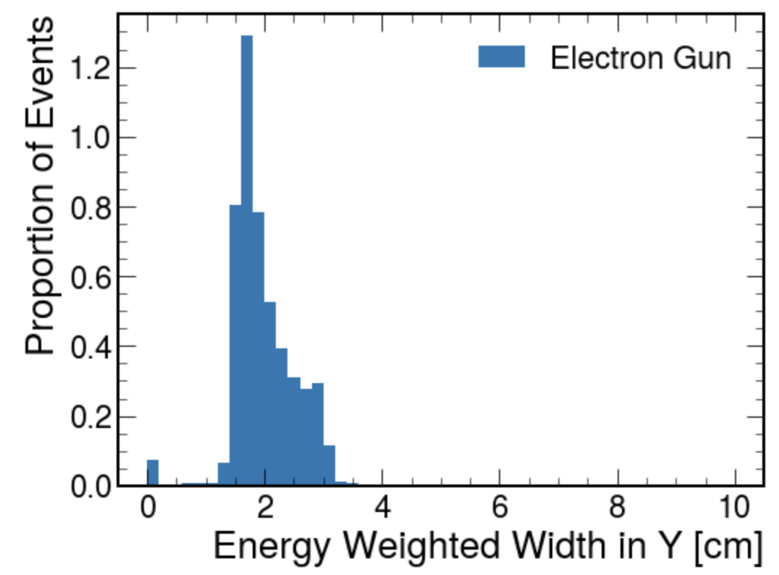
Energy Weighted Width - Electron

Slide 30
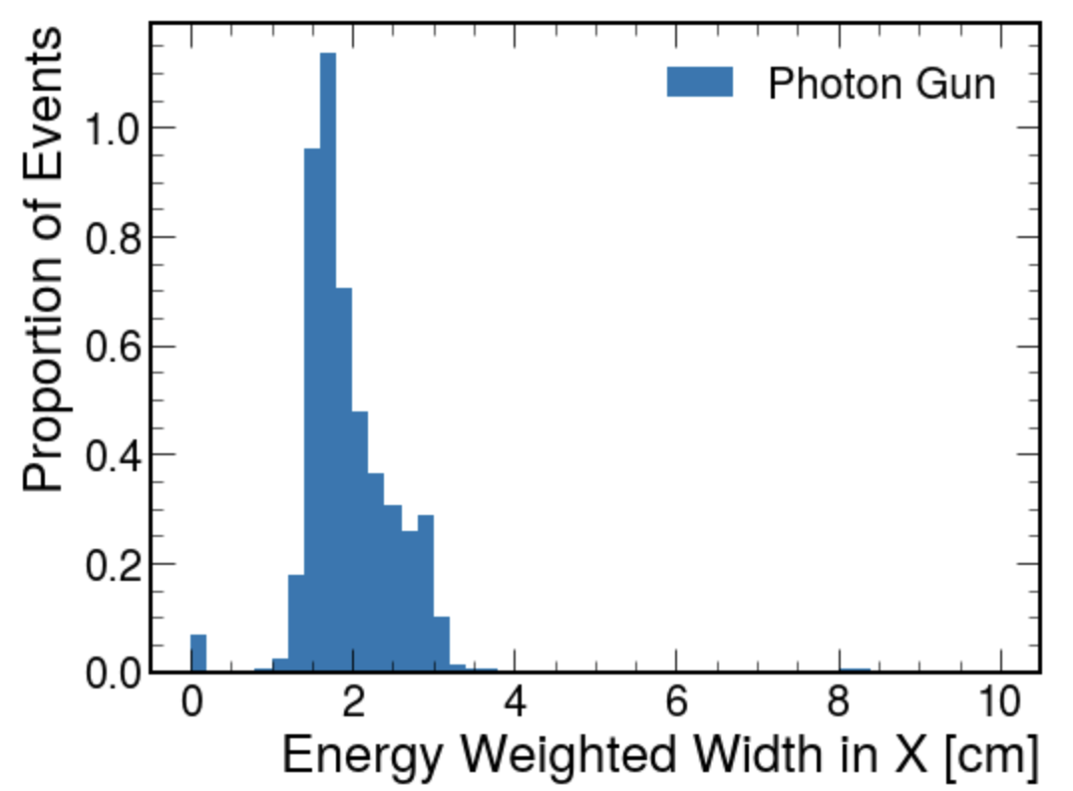

Energy Weighted Width - Photon

Slide 31


Energy Weighted Width - Pi+

Slide 32


Energy Weighted Width - Pi0

Slide 33


Energy Weighted Width - Kaon

Slide 34


Energy Weighted Width - Muon

Slide 35

Width

Slide 36


Width - Electron

Slide 37


Width - Photon

Slide 38


Width - Pi+

Slide 39


Width - Pi0

Slide 40


Width - Kaon

Slide 41


Width - Muon

Slide 42
Distance Between Cluster and Track Extrapolation
(Extrapolation seems to not be working properly)

Slide 43

Distance Between Cluster and Track Extrapolation - Electron

Slide 44

Distance Between Cluster and Track Extrapolation - Photon

Slide 45

Distance Between Cluster and Track Extrapolation - Pi+

Slide 46

Distance Between Cluster and Track Extrapolation - Pi0

Slide 47

Distance Between Cluster and Track Extrapolation - Kaon

Slide 48

Distance Between Cluster and Track Extrapolation - Muon

